Slide 1
Word2Vec

Slide 2
Word2Vec Introduction
You shall know a word by the company it keeps
(Firth, J. R. 1957:11)
Challenges in Bag-of-words/TF-IDF:
Huge dimensionality
Sparsity
Unable to relate similar terms Eg: Teachers & Lecturers
Unable to relate the context where the word is being used Eg: ‘Duck’ means different in each of these below sentences:
The kids love seeing the ducks at the lake
The opening batsman was out for a duck!!
The soldier had to duck for cover
Cannot account for the new unseen words while scoring the model

Slide 3
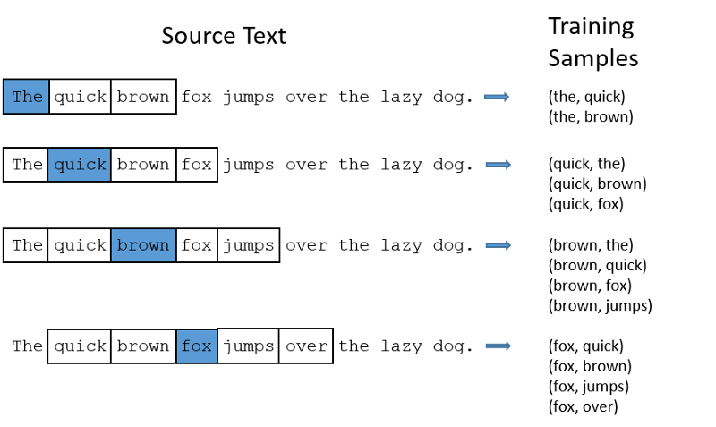
Word2Vec Context
The main idea is to represent the word as a vector, which is actually a function of its neighboring words, i.e. the Context
Context window

Slide 4
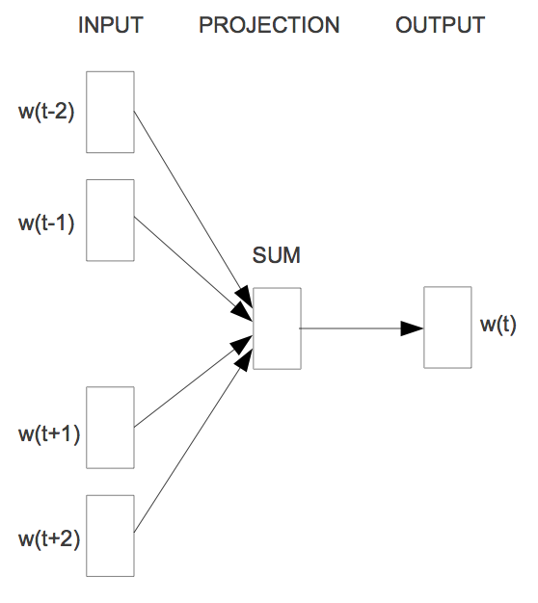
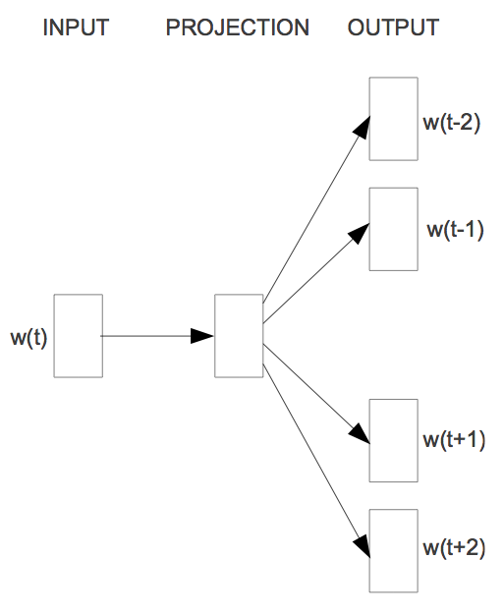
Word2Vec Algorithms
There are two variants of algorithms used:
Continuous Bag of Words (CBOW) : Predict the center word, given the context
SkipGram: Predict the neighbors, given the center word

Slide 5
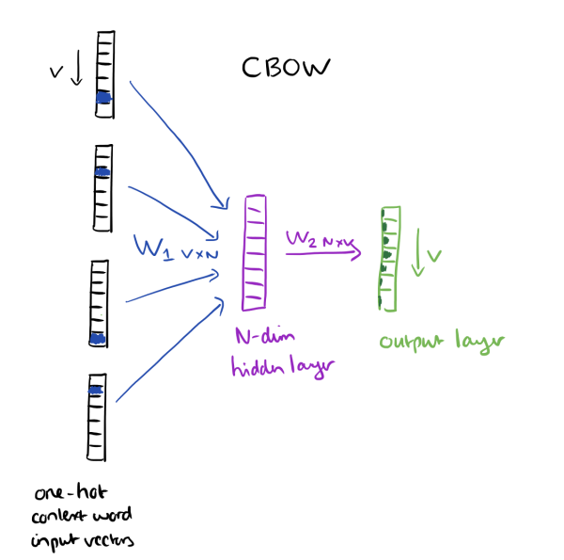
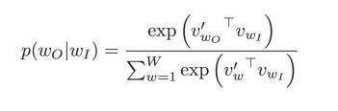
CBOW Detailed steps
The input will be a one-hot encoded vectors from the input context window
The input feeds into a N-dimensional hidden layer
The hidden layer in turns maps to the output layer
The hidden-output weights learned will be the word-vectors learned
Objective Function

Slide 6
Training the Word2vec – hyper parameters
Negative Sampling: Since computing the neighborhood of all the negative words will be expensive for each iteration, for each words, we employ the negative sampling which will reduce the computation time
Some of the hyperparamters that can be tuned are:
Vector length
Algorithm (CBOW/Skipgram)
Context window size
Learning rate of the neural network
Negative sampling rate

Slide 7
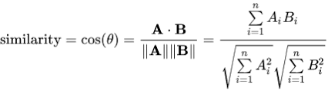
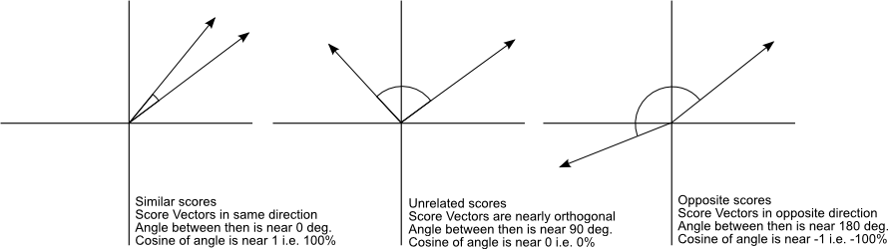
Vector Space and Similarity
The vectors generated by the word2vec represents some vectors in the N-dimensional space. The cosine of the angle between the two vectors determine the similarity between the two words
The Cosine Similarity values for different words, 1 (same direction), 0 (90 deg.), -1 (opposite directions).

Slide 8
Extending the Word2Vec to sentences
Vector - elementwise averaging of words in the sentence
Vector - elementwise sum of words in the sentence
TF-IDF weighted averages of words in the sentence
Studying the sequence of the word vectors in a sentence and encoding them (Seq2Seq auto encoders)
Once the sentence vectors are derived, one can use the resultant vectors as features in the clustering/classification framework.

